Slide 1


New York City AirBnb Case Study
Presented by: Group 8
Presenters : Neha , Bowen , Tammy , Yejiao , Alex

Slide 2
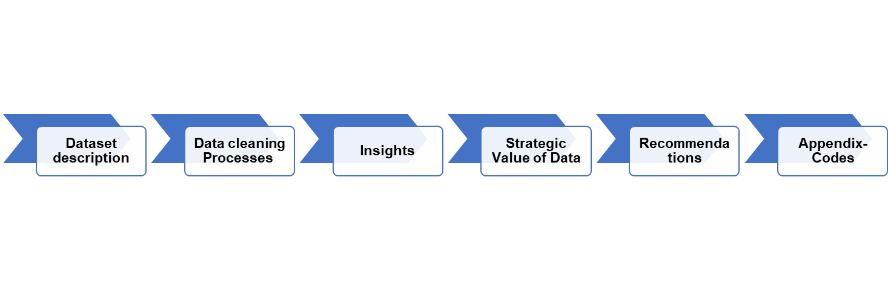
CONTENT

Slide 3
COMPANY OVERVIEW
Since 2008, guests and hosts have used Airbnb to expand on traveling possibilities and present more unique, personalized way of experiencing the world. This dataset describes the listing activity and metrics in NYC, NY for 2019. This data file includes all needed information to find out more about hosts, geographical availability, necessary metrics to make predictions and draw conclusions.

Slide 4
OBJECTIVES
Get a better understanding about Airbnb listings with respect to various parameters
Understand the customer preferences
Understand the customer booking trend
What can we learn about different hosts and areas?
What can we learn from predictions? (ex: locations, prices, reviews, etc)
Which hosts are the busiest and why?
Is there any noticeable difference of traffic among different areas and what could be the reason for it?

Slide 5
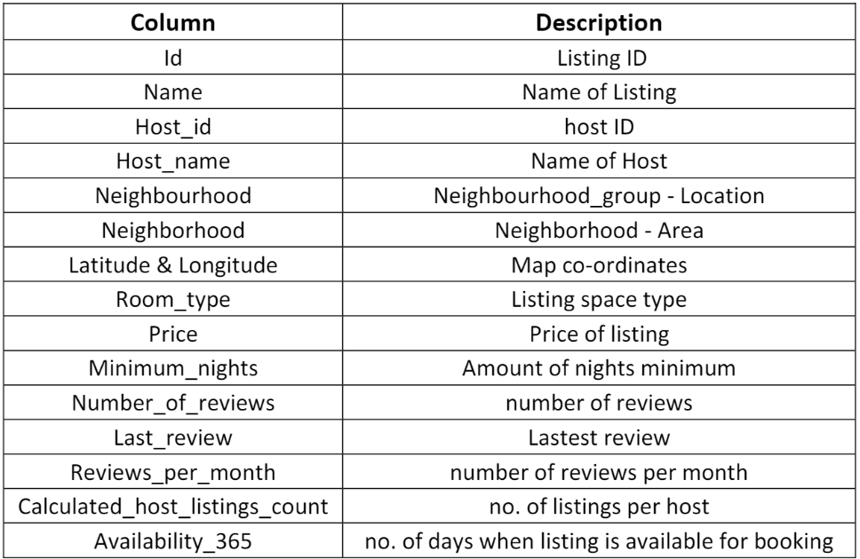
DATA SET DESCRIPTION

Slide 6
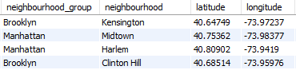
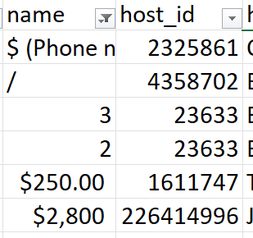
DATA PREPARATION
Drop unnecessary columns like “latitude” and “longitude”, since column “neighborhood” and “neighbourhood_group”provides a much better representation of the geographic location of the airbnb listings.
By eliminating these entries with incomplete or irrelevant information, such as listings with no proper names or names consisting only of numbers, the dataset was refined, facilitating more meaningful insights and enhancing the overall quality of the data.

Slide 7
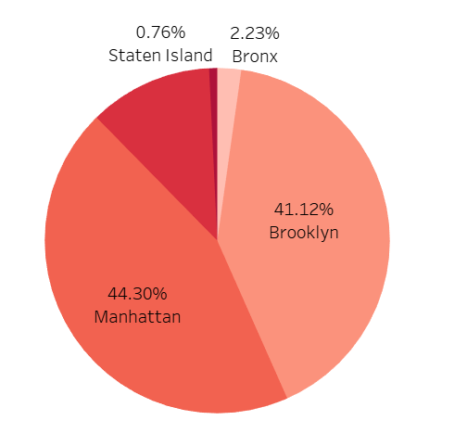
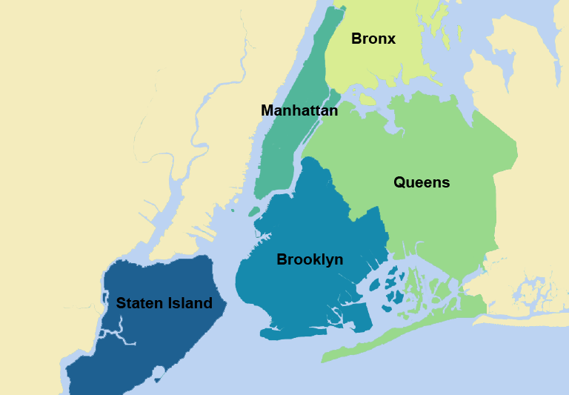
DATA ANALYSIS
This representation shows an overview of the distribution of Airbnb listings across the distinct neighborhood groups.
Notably, Manhattan and Brooklyn boast the most substantial numbers of listings, while Bronx exhibits the fewest listings among the analyzed group.

Slide 8
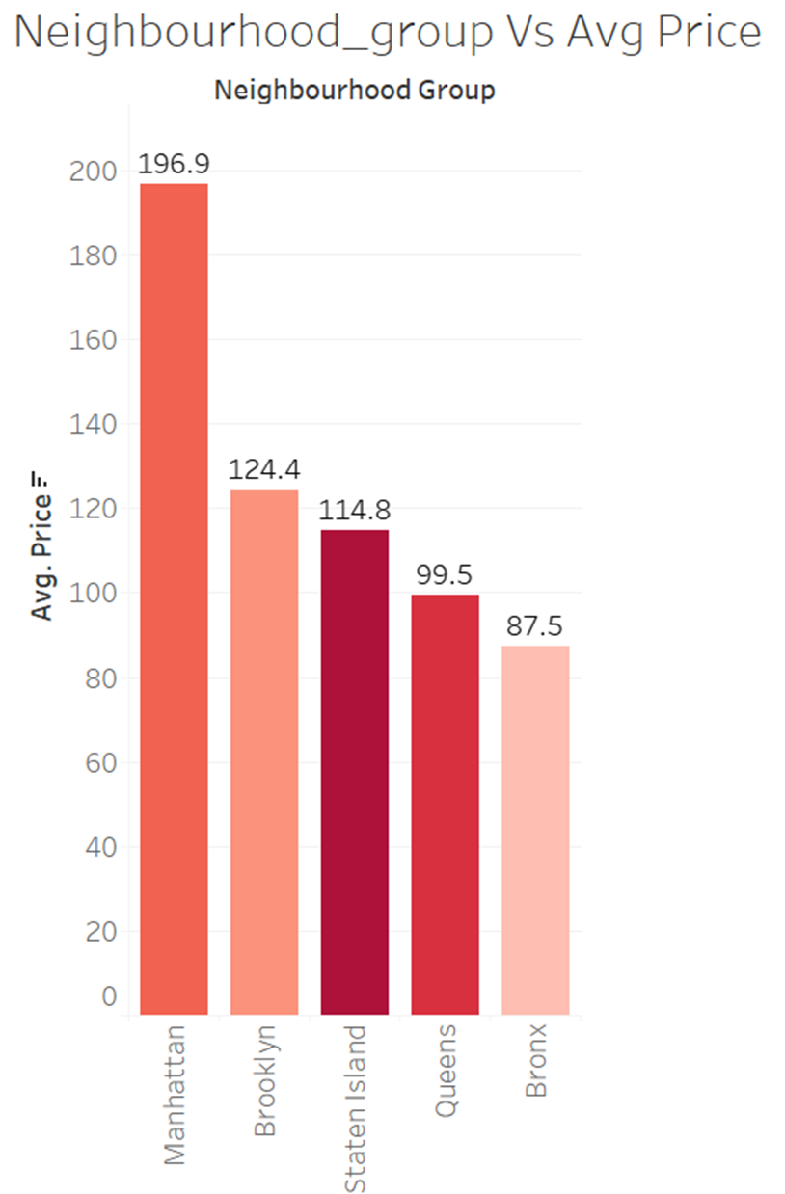
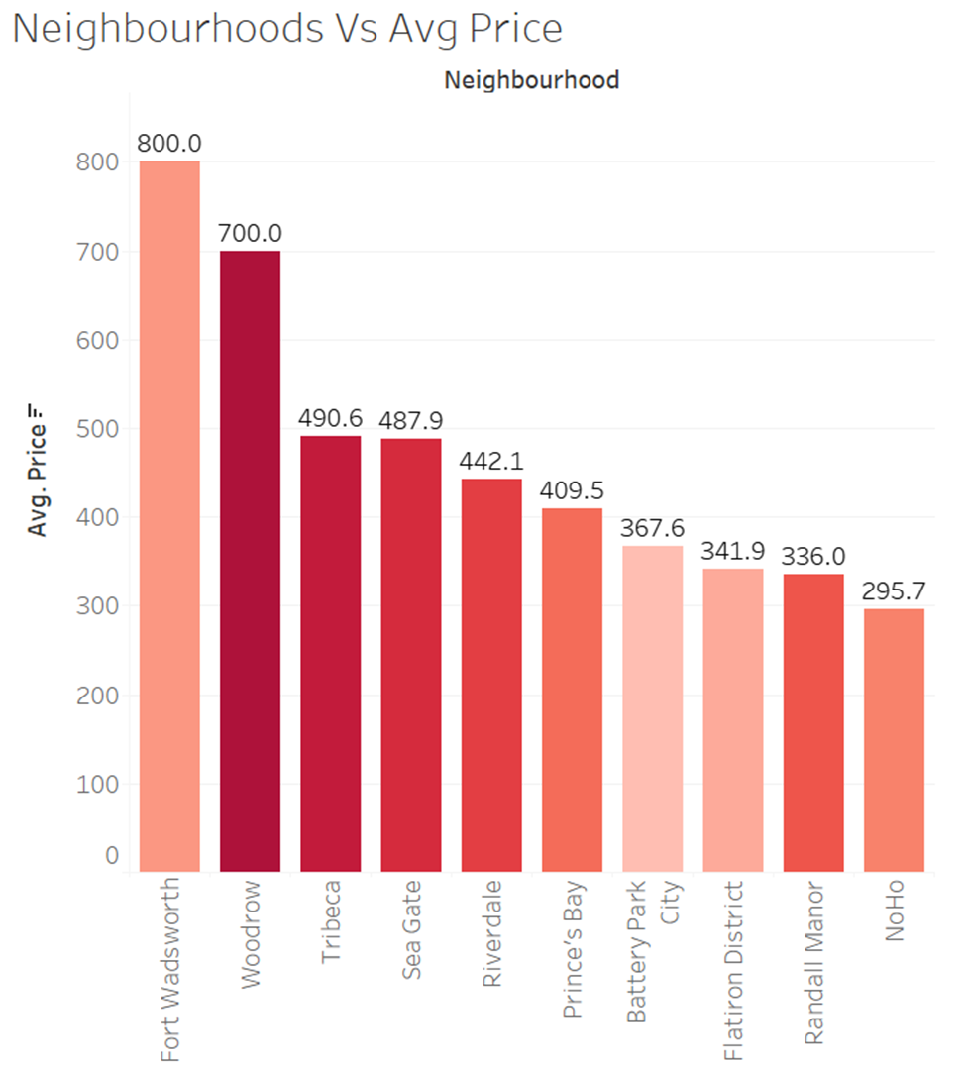
Insight #1

Slide 9
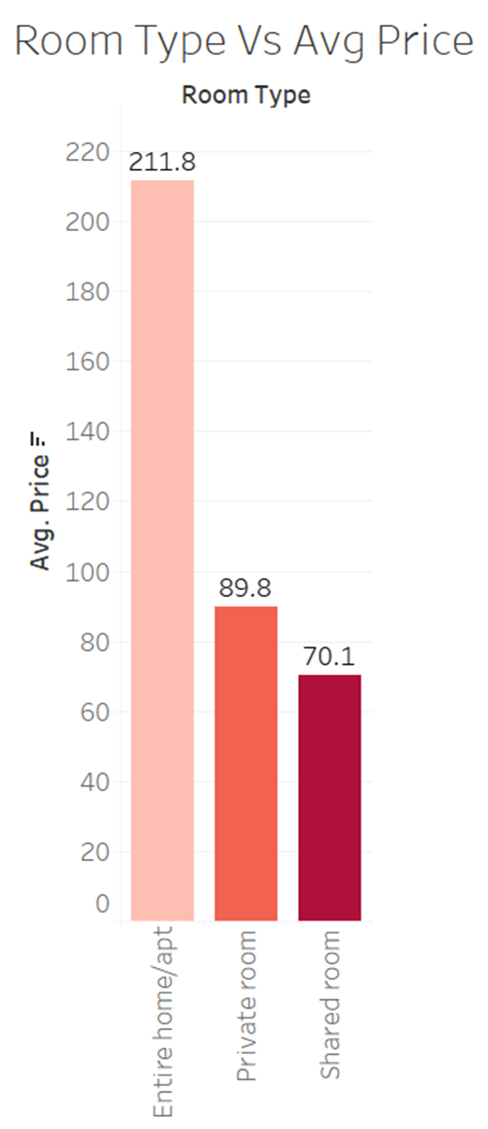
Insight #2
Comparison between average prices Vs various types of rooms
Private rooms costs only 19.7 more than a shared room but having the whole place to yourself costs more than double !

Slide 10
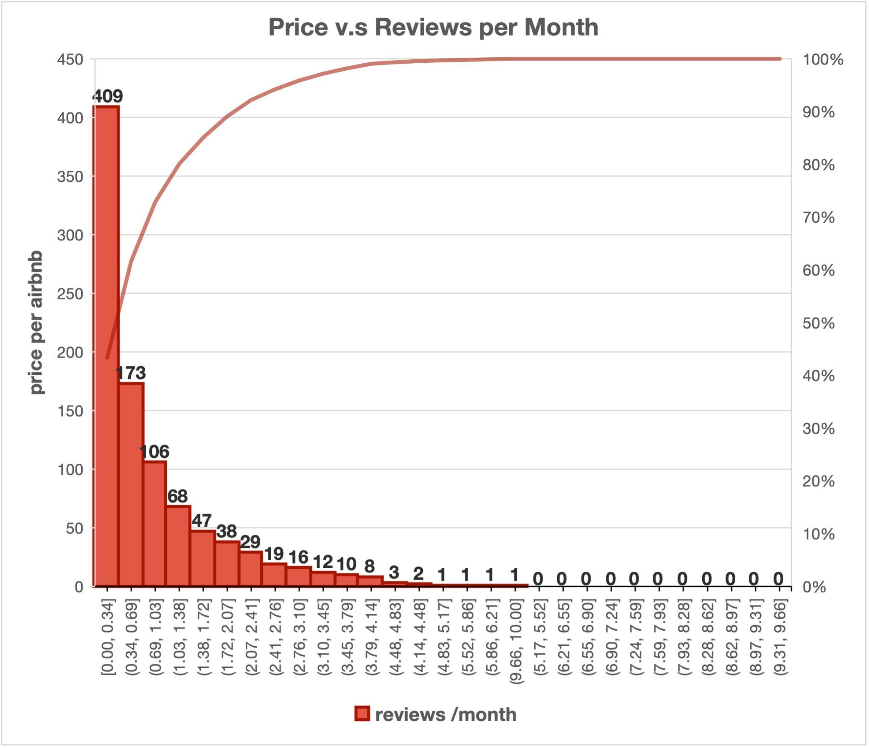
Insight #3
From the chart, we can see that when the room price is higher, the reviews per month is lower.
On the other hand, when the room price is lower,
the reviews per month increased.

Slide 11
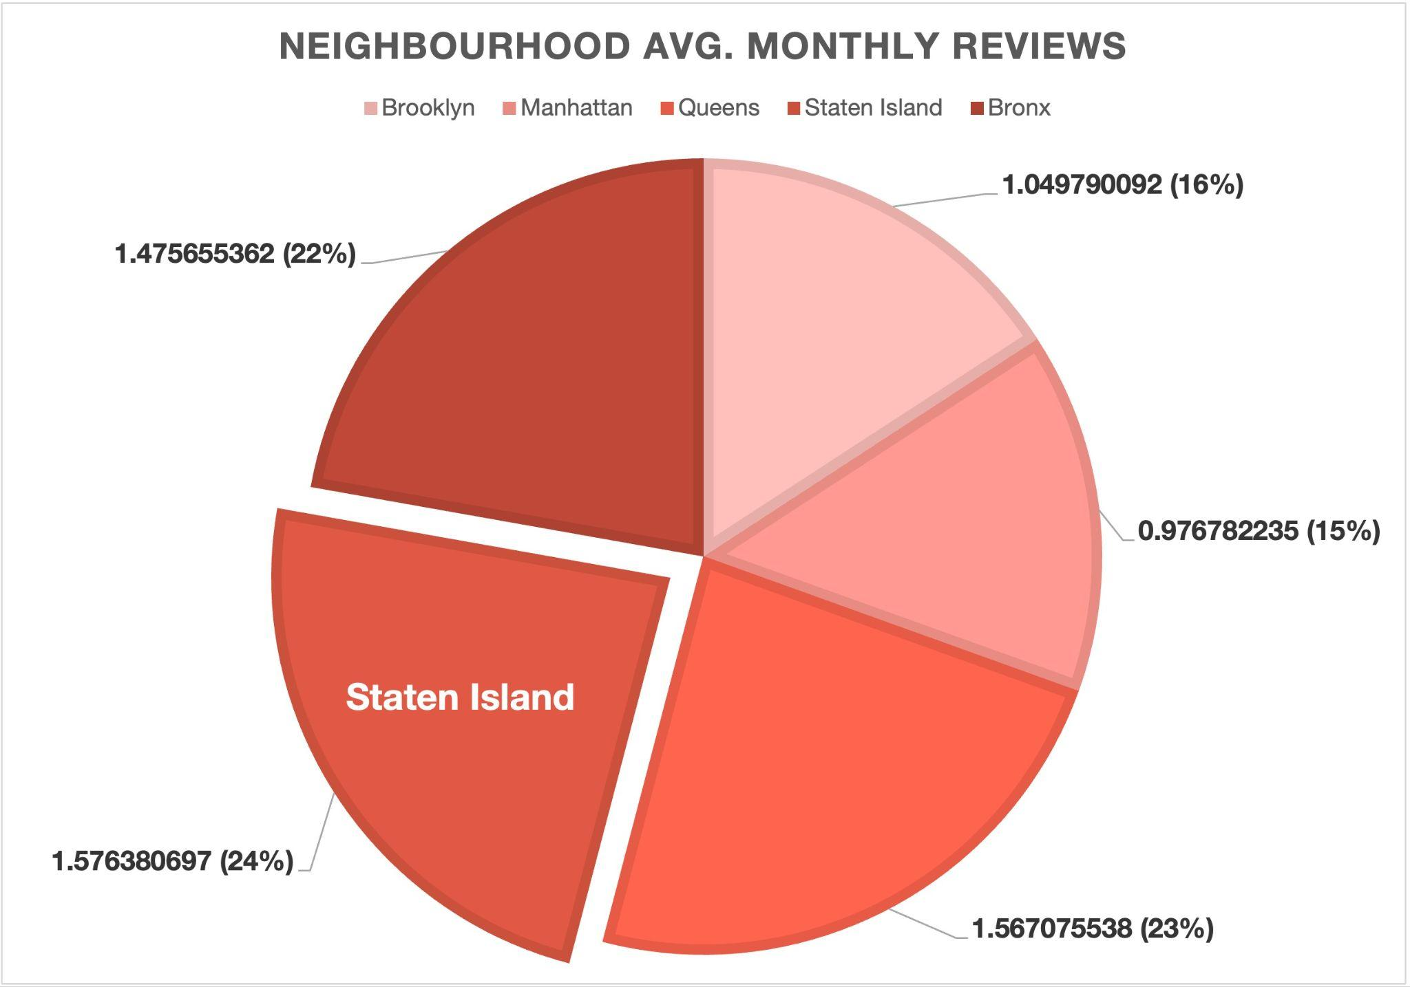
Insight #4
Even though Brooklyn and Manhattan boast the most substantial numbers of listings, the average monthly reviews for these two areas are only 1.05 and 0.98.
Surprisingly, low listing areas - Staten Island, Bronx, and Queens have higher monthly reviews: 1.58, 1.57, and 1.48.
Brooklyn
Bronx
Manhattan
Queens

Slide 12





Insight #5
Lovely?
Modern?
Luxury?
Spacious?
Loft?

Slide 13
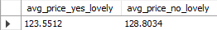
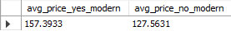
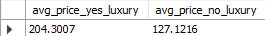
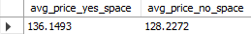
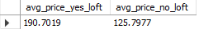
Insight #5
Lovely?
Modern?
Luxury?
Spacious?
Loft?
Listings described to be lovely on average are cheaper than those not described to be lovely!
Modern listings will cost you more based on our analysis!
Luxury listings will cost you significantly more!
Spacious listings are more affordable than you think!
Want to try Loft Style?! You should expect pay more!!

Slide 14

Who is the King of Airbnb in NYC?
Name: Sonder
Listings: 327

Slide 15

Where are his properties?
Where are his properties?

Slide 16
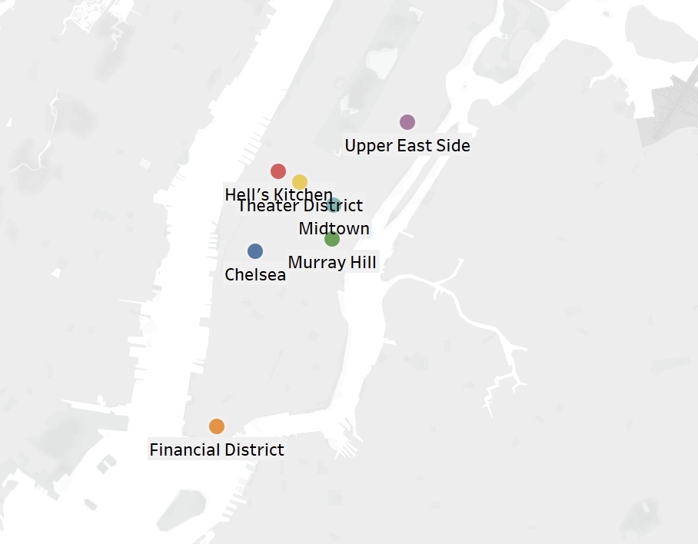
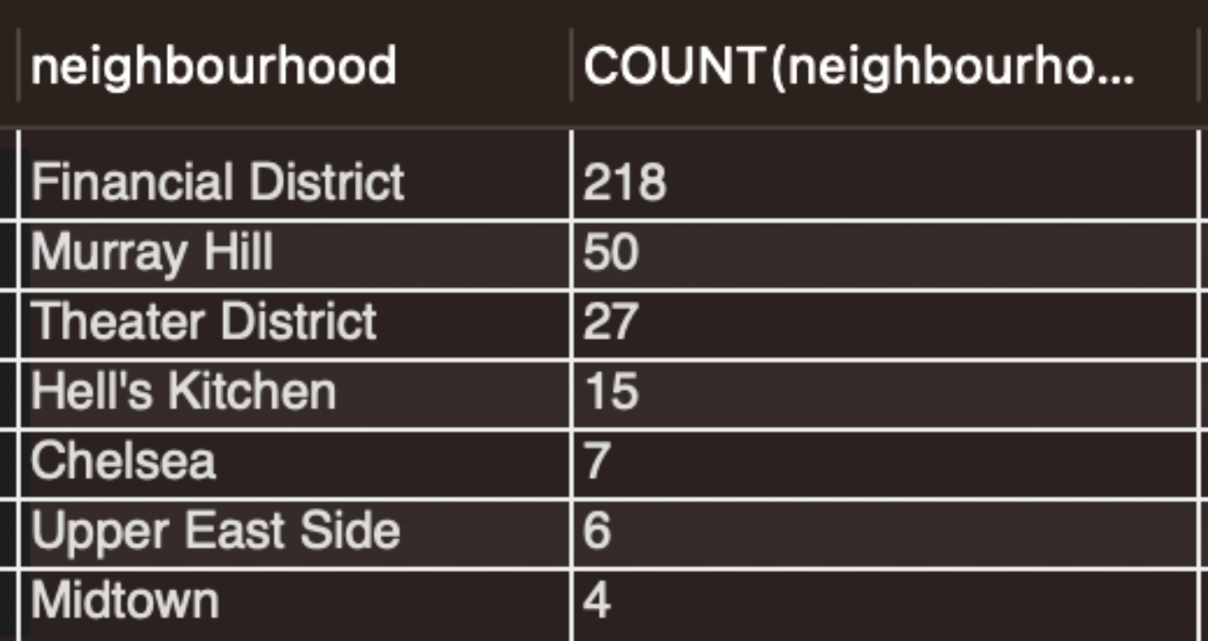
What Neighborhood?

Slide 17
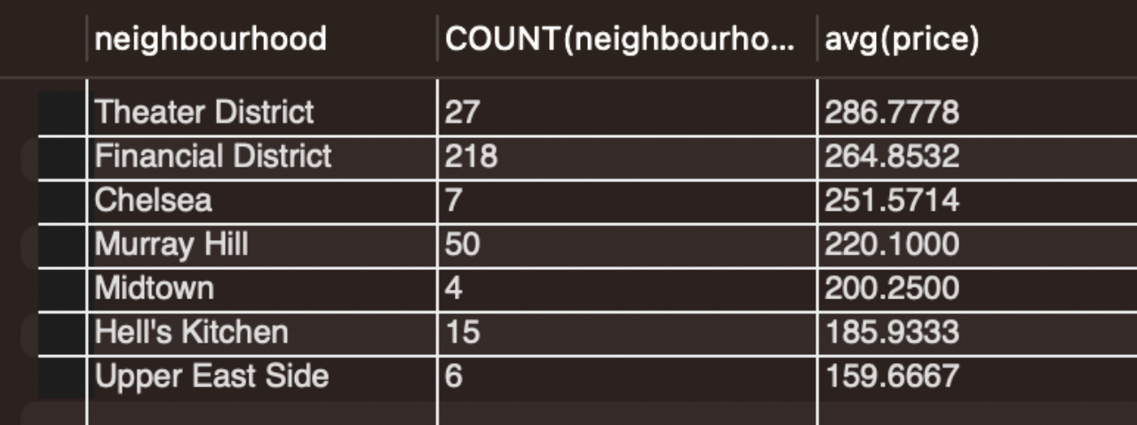
How much is Sonder Charging in each neighborhood?

Slide 18
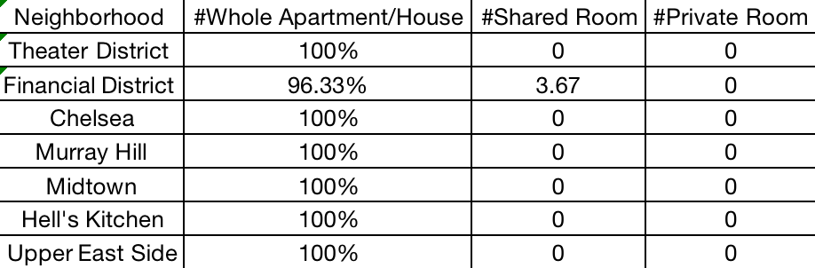
What type of places does Sonder provide in each neighborhood?

Slide 19
STRATEGIC VALUE
For Hosts
For Renters
Hosts might tailor their real estate portfolio according to the:
Average Rent for each neighborhood and room type
Expected review for each neighborhood and room type
Keywords in title to use or avoid according to rent.
Sonder’s Airbnb portfolio
AirBnb Users may choose their night of stay according
to :
Average Rent for each neighborhood and room type
Expected review for each neighborhood and room type
Being conscious about the potential premium that is associated with certain keywords.

Slide 20
Conclusion
In conclusion, this analysis provided a comprehensive analysis of the Airbnb listings in New York City, offering valuable insights into the rental landscape in the city.
The insights gained from this analysis could be useful for both hosts and renters in making informed decisions.
Although we drew valuable insights from the data, there are natural limitations that the data presents. Additional data like booking information or cleaning fee will benefit hosts and customers further.

Slide 21
THANK YOU !

